Slide 1
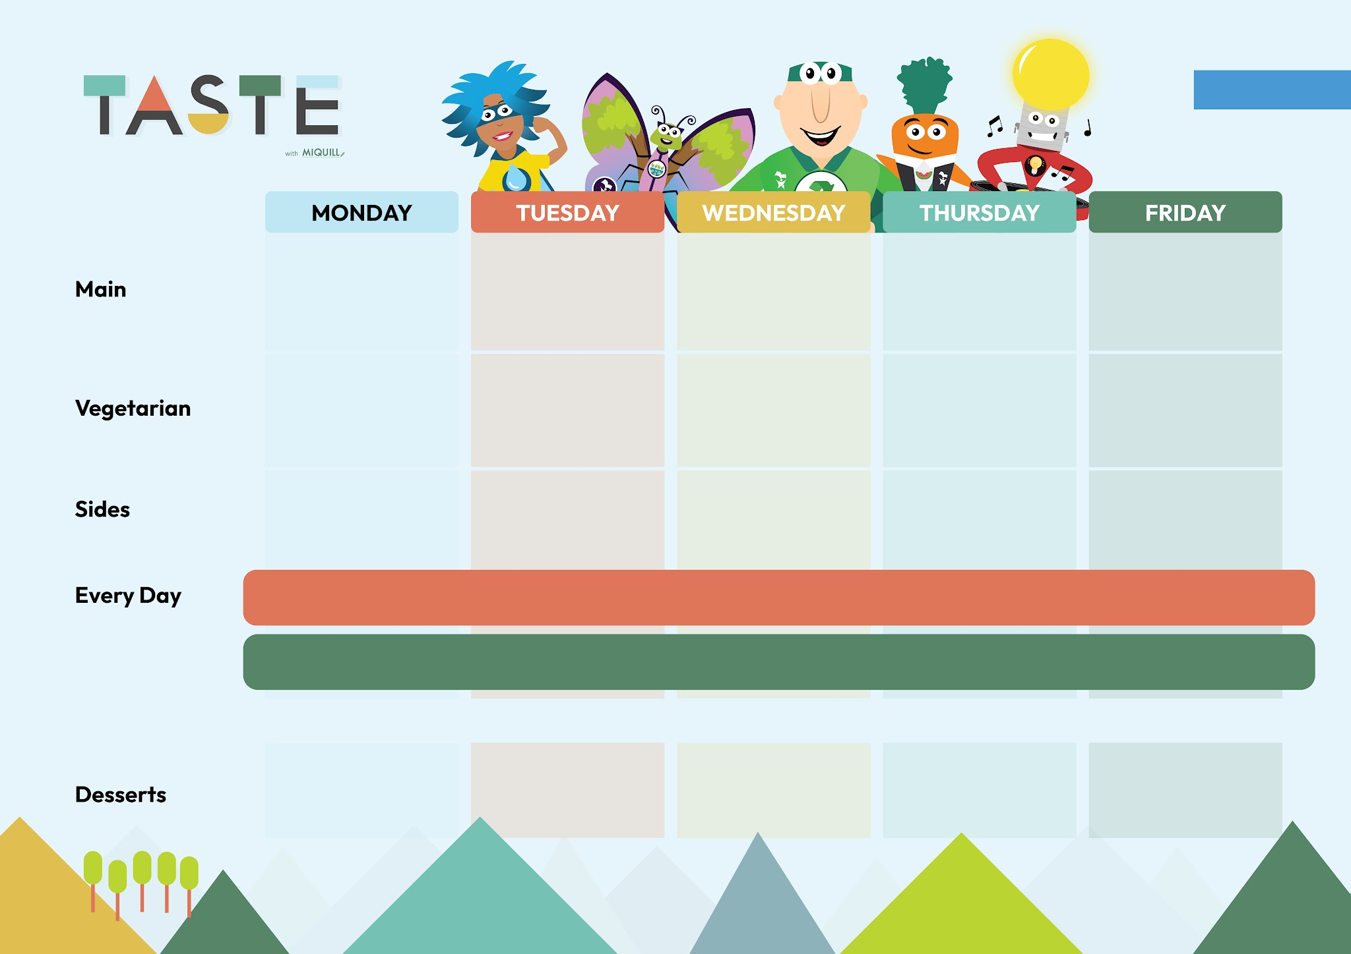

Week 1
WEEK COMMENCING:
31/08, 21/09, 12/10, 02/11, 23/11, 14/12, 04/01, 25/01
Winter Veg Cobbler | Mac n Cheese Pasta Bake | Roast Quorn Fillet | Margherita Pizza with Wedges | Cheese and Onion Slice
BBQ Chicken | Ham and Pineapple Pizza And Wedges | Roast Chicken | Cottage Pie | Fish Fingers
Wholegrain Rice and Broccoli | Sweetcorn and Peppers | Roasties and Carrots | Peas | Chips and Beans
Flapjack | Rainbow Cookie | Chocolate Chip Shortbread | Pineapple Upside Down Cake with Custard | Banana Custard Crunch
Option 1
Option 2
Pasta with Homemade Tomato Sauce | Jacket Potato with Cheese or Beans
Freshly Filled Baps and Salad Bar are also available
Fresh Bread and Salad is available daily with a choice of Yoghurt, Jelly or Fruit instead of dessert

Slide 2
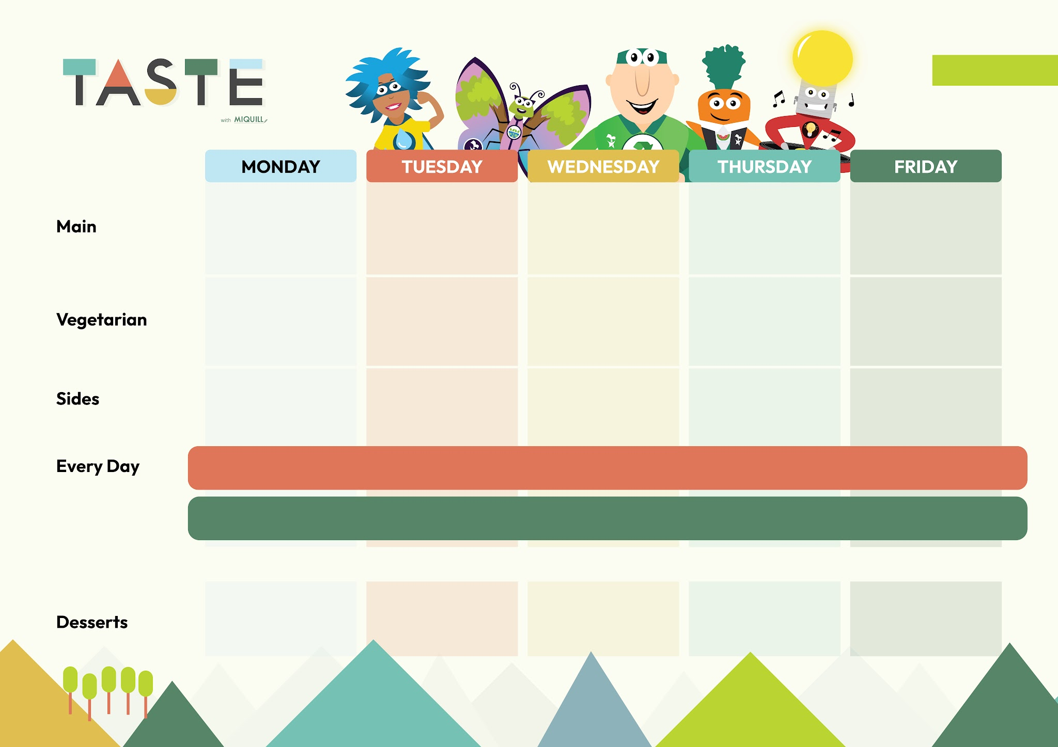
Week 2
WEEK COMMENCING:
07/09, 28/09, 19/10, 09/11, 30/11, 21/12, 11/01, 01/02
Homemade Veg Burger | Margherita Pizza and Wedges | Roasted Vegetable Crown | Mac n Cheese Pasta Bake | Cheesy Bean Wrap
All Day Brunch with Sausage | Chicken Pasta Bake | Roast Gammon | Mild Chicken Curry with Wholegrain Rice | Fishcake
Hash Brown and Beans | Rainbow Slaw | Mash, Carrots and Gravy | Roasted Cauliflower | Chips and Peas
Marbled Shortbread | Apple Crumble with Custard | Carrot Cake | Jam and Coconut Sponge with Custard | Oaty Biscuit
Pasta with Homemade Tomato Sauce | Jacket Potato with Cheese or Beans or Salmon Mayonnaise (on Tuesday)
Freshly Filled Baps and Salad Bar are also available
Fresh Bread and Salad is available daily with a choice of Yoghurt, Jelly or Fruit instead of dessert

Slide 3
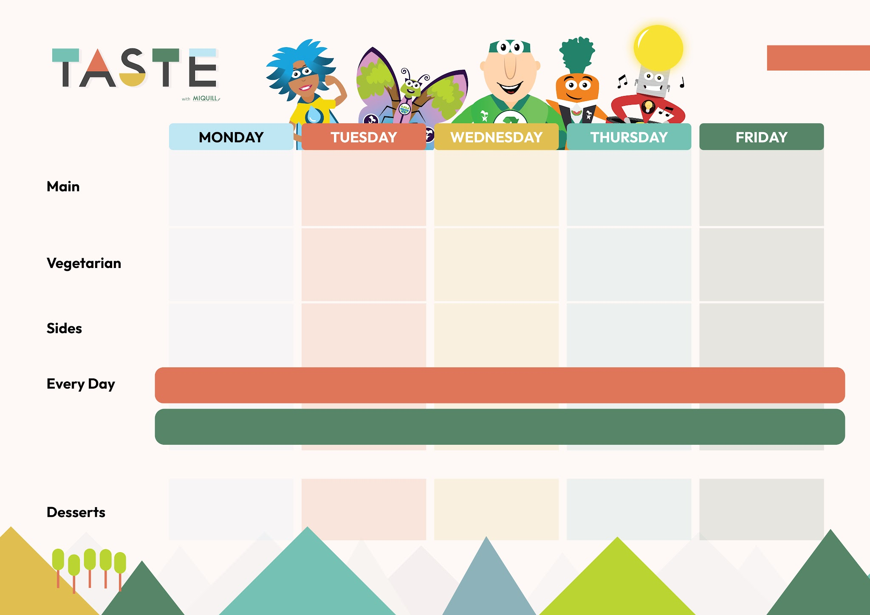
Week 3
WEEK COMMENCING:
14/09, 05/10, 26/10, 16/11, 07/12, 28/12, 18/01, 08/02
BBQ Veg Pitta | Cheese and Tomato Pizza and Wedges | Roast Quorn Fillet | Mac n Cheese | Cheese and Potato Pasty
Beef Burger | Bolognese Pasta Bake | Roast Chicken | Chicken Pitta and Rainbow Rice | Fish Fingers
Diced Potatoes and Green Salad | Sweetcorn | Roasties, Cabbage and Gravy | Carrots | Chips and Peas
Lemon Cookie | Banana Sponge with Custard | Lime and Courgette Cake | Shortbread | Chocolate Brownie
Pasta with Homemade Tomato Sauce | Jacket Potato with Cheese or Beans
Freshly Filled Baps and Salad Bar are also available
Fresh Bread and Salad is available daily with a choice of Yoghurt, Jelly or Fruit instead of dessert

