Slide 1


Meet The Teacher
Y2
Autumn 2026
Thursday 10th July 2026
Class Teachers – Mrs. Forrester & Miss Siddorn
Teaching Assistant- Mrs. Palser
“We ASPIRE to be our best”

Slide 2
Overview of the Year
What to expect this year.
“We ASPIRE to be our best”

Slide 3


School Life
If your child is unable to attend school, please either telephone the school office on 01270 449560 or email offleyadmin@sbmat.org with your child’s full name, class and reason for absence.
Regular attendance is extremely important as it promotes good outcomes for children. It has a positive impact on children's cognitive and social development.
If there are any issues that may be impacting on your child’s attendance, and you would like any support please contact the school office to arrange a meeting with Mrs Morgan who is the School's Family Support Officer.
Attendance
Punctuality
Uniform expectations – please see the uniform policy for school uniform and PE kit. School shoes. No make-up or jewelry. Long hair to be tied up – hair of natural colour. Waterproof coat as we go outside in all weathers for fresh air and movement.
Daily – named water bottle, snack if needed and reading books.
“We ASPIRE to be our best”

Slide 4
School Life – Year Two
If your child is Support Officer.
We are trying things differently this year!
Whole class mornings – Phonics, maths and English will be taught whole class every morning.
In the afternoons we will be using an approach the children are familiar with in Year 1 called continuous provision. Children will work in small focus groups with their teacher. When not in groups they choose one of the learning tasks set in provision to complete. COOL time = Choose our own learning.
As the year progresses (to get your child ready for moving into the juniors), gradually whole class teaching will be across the full day.
“We ASPIRE to be our best”

Slide 5
Times Tables – Y2
From Year 2 onwards your child will take part in times table tests. They have 4. minutes to answer 30 questions based on the times table they are on.
They need to achieve 29/30 to pass a times table before going onto their next.
Order and Awards.
Bronze - 10x, 5x 2x then mixed.
Silver – 3x, 4x, 8x, 6x then mixed.
Gold – 7x, 9x, 11x, 12x then mixed.
Number Bonds rapid recall quizzes order (Autumn Term)
Number bonds to 5
Number bonds to 10
Number bonds to 20
Number bonds to 100
“We ASPIRE to be our best”

Slide 6
Reading in Y2
Y2 complete the phonics programme at the end of the Autumn Term. From here the children focus on the comprehension of reading. Your child will be given a username and password from Accelerated Reader (AR)
Children get a reading range e.g. 1.2-2.4 and can choose books from within this range. These expose the children to a bigger variety of books –such as picture books, graphic novels etc. The books might seem easier but please remember they aren’t as the texts will no longer be phonetically decodable.
After your child has read the book, they them complete an accelerated reader quiz – where there are 3-5 multiple choice questions to test their comprehension.
“We ASPIRE to be our best”

Slide 7



Reading and Homework
Reading - Please listen to your child read at least 3 times per week.
Reading aloud to an adult helps children to build fluency, accuracy and expression when reading. Talking to your child about what they have read and asking questions really helps to improve their important inference skills. Repeating this regularly makes such a difference to their reading confidence which helps their learning across all areas of the curriculum.
Homework – Homework is set on a Friday and we be due in on the following Wednesday. There will usually be one piece of maths or English/spelling homework to help your child to consolidate their learning and increase independence. If your child is struggling with any aspect of homework, please see their class teacher in advance of the due date and they will be happy to support.
Spellings – No spelling tests. Spellings can be practiced at home through homework tasks. From Y2 upwards spellings can consolidated on a interactive spelling game call ‘Morphs’.
Times Tables - In year 2, please spend time practising rapid recall and division facts with your child for 2x, 5x, 10x tables
We appreciate lives are busy but completing reading and homework strengthens the partnership between school and home. It also forms good habits in preparation for high school.

Slide 8
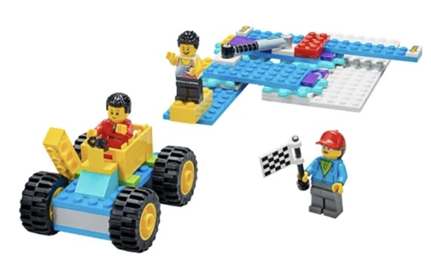
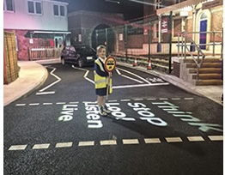
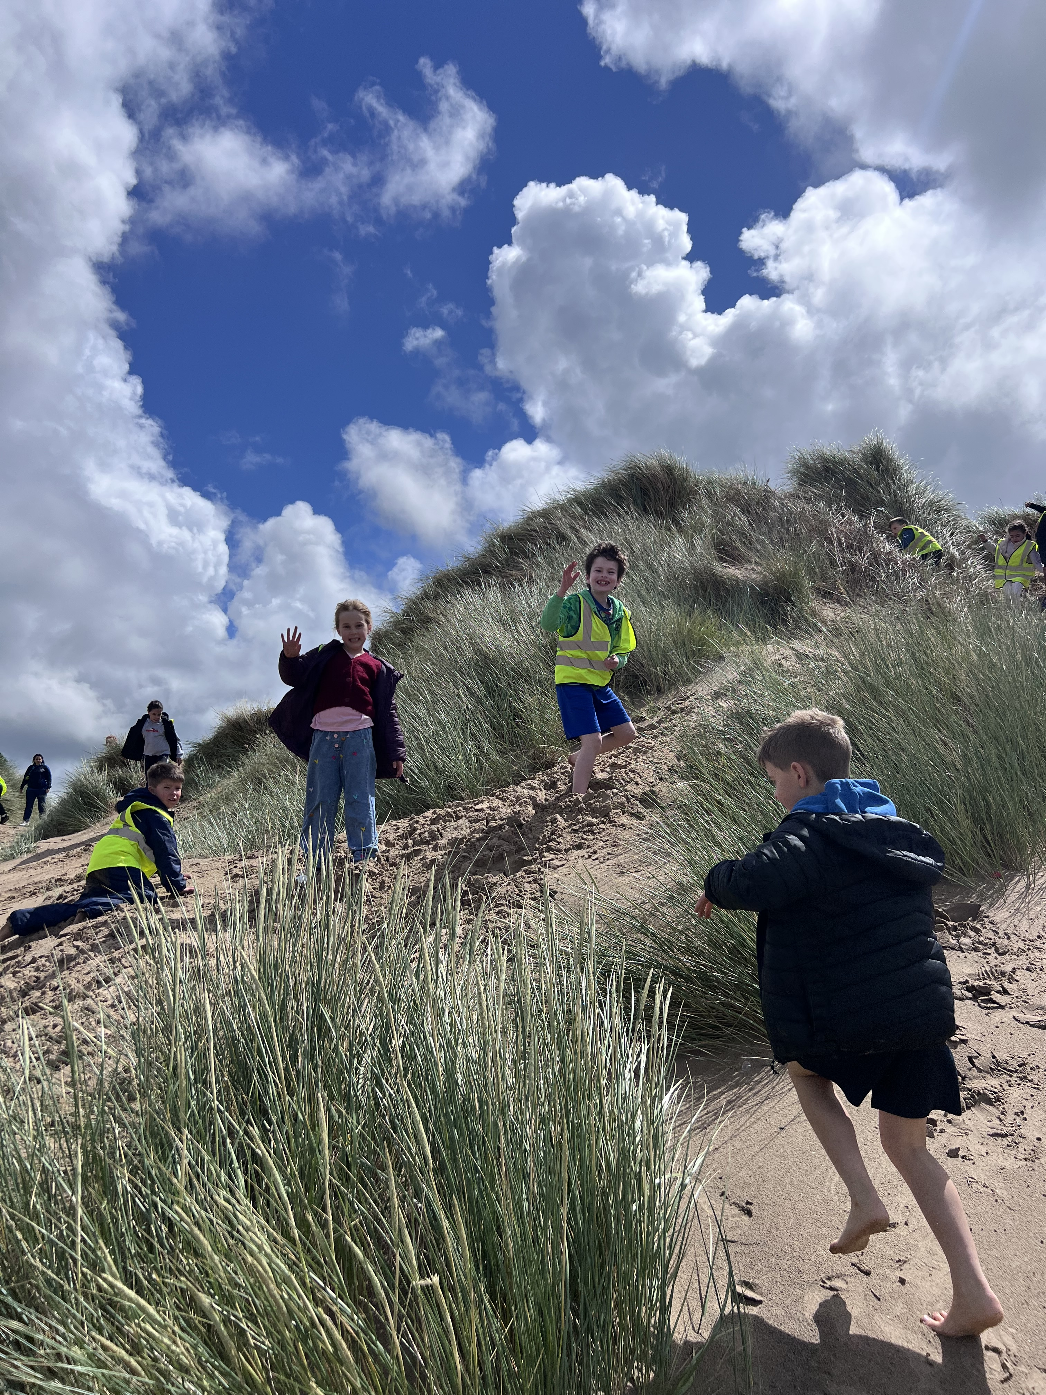
Trips
LegoLand Discovery Centre - (D&T)
Wheels and Axles workshop
Safety Central - Safety Stars Programme / PSHE
An “indoor village” featuring themed safety zones.
Formby Beach- Geography focus
Explore the physical and human features of a beach
“We ASPIRE to be our best”

Slide 9

The Offley Values:
“We ASPIRE to be our best”

Slide 10
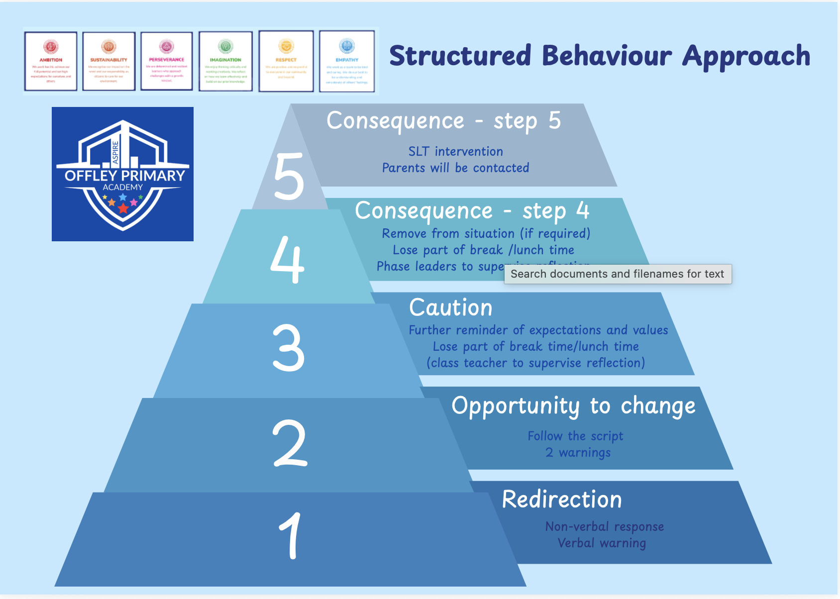
Behaviour Policy
“We ASPIRE to be our best”

Slide 11
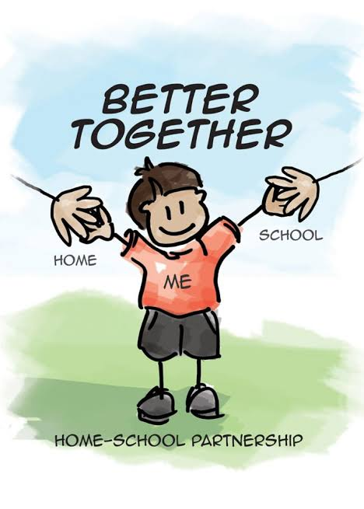
Home – School Partnership
Together as one – school, pupil and family – working together to nurture every child so they thrive, achieve and ASPIRE to be their very best.
“We ASPIRE to be our best”

Slide 12
Communication
Where can I find out about what my child is learning?
Each term we will share knowledge organisers for each subject on the class page which can be found on the school website. This gives information about key learning and vocabulary to help support learning at home.
Where can I find important dates?
The school calendar can be found on the school website. This is regularly updated with key dates for your diaries.
“We ASPIRE to be our best”

Slide 13
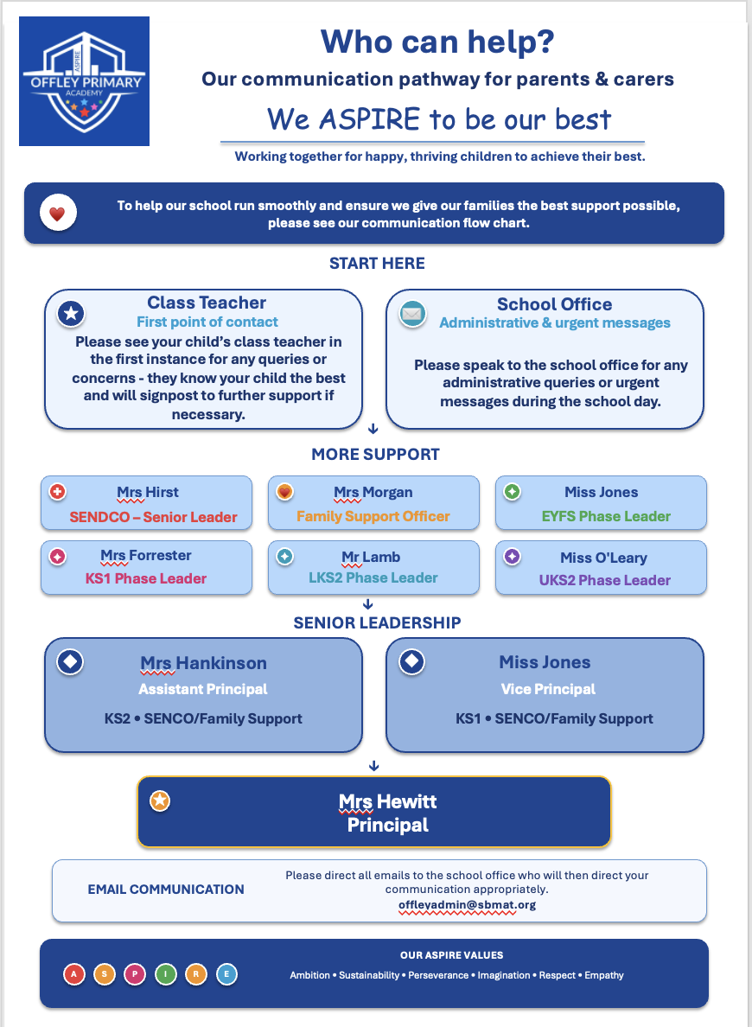
If you need support….
To help our school run smoothly and ensure we give our families the best support possible, please see our communication flow chart.
School office – please contact for administrative queries and urgent messages during the school day.
Please always contact your child’s class teacher in the first instance for additional support, queries or concerns. They know your child the best and are always happy to help. They will always do their best to reply promptly but please bear in mind that they are teaching during the school day and may have clubs, training or meetings after school so it may not be instant.
Depending on the nature of your query, the class teacher may then signpost to another member of the leadership team. If you are not satisfied with a response from the class teacher, please contact the relevant phase leader for your child’s year group. Thank You.

Slide 14


